Slide 1

Engineering Mechanics
Lecture -6

Slide 2
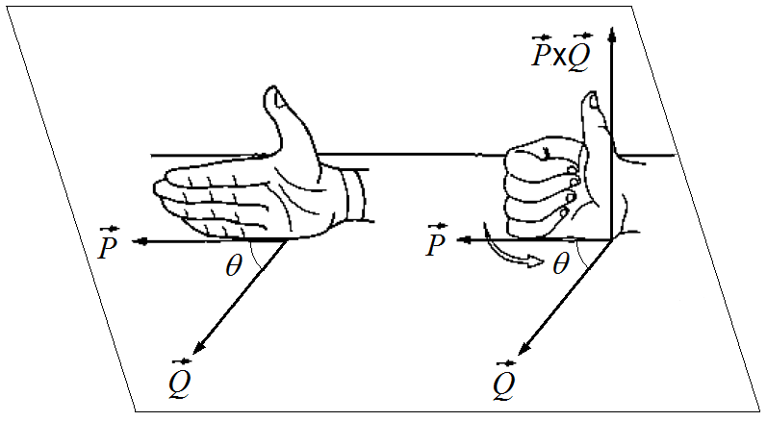
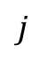
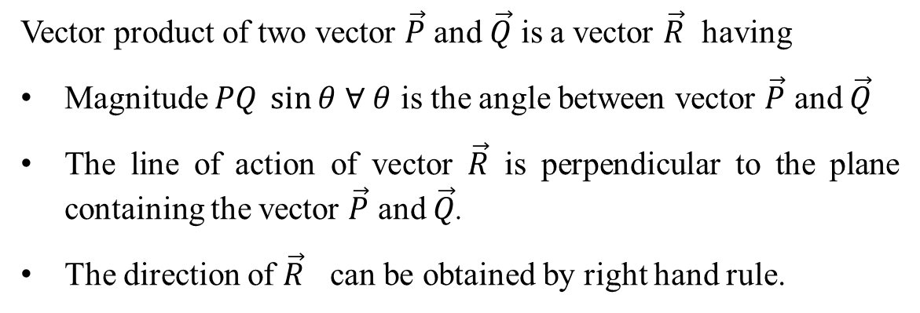
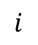
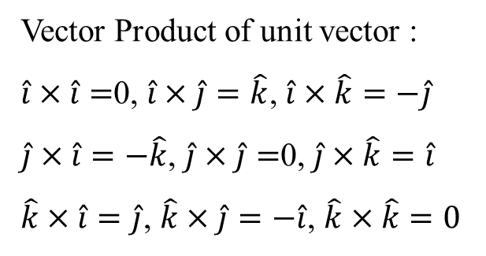
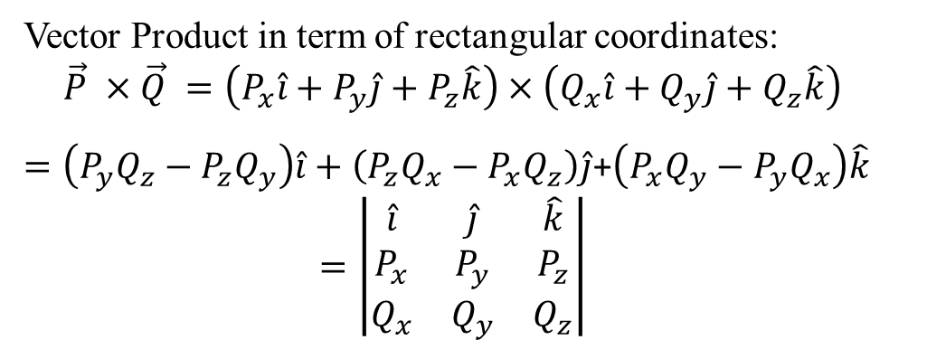
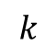
Cross Product (Vector Product)
Vector product of two vector $\vec{P}$ and $\vec{Q}$ is a vector $\vec{R}$ having
Magnitude $PQ \sin{θ}$ $∀$ $θ$ is the angle between vector $\vec{P}$ and $\vec{Q}$
The line of action of vector $\vec{R}$ is perpendicular to the plane containing the vector $\vec{P}$ and $\vec{Q}$.
The direction of $\vec{R}$ can be obtained by right hand rule.
Vector product are neither commutative nor associative but are distributive.
$\vec{P}$ $×\vec{Q}$ $=−\left(\vec{Q} ×\vec{P}\right)$, $\left(\vec{P} ×\vec{Q}\right)×\vec{R}≠\vec{P}×\left(\vec{Q} ×\vec{R}\right)$ and $\vec{P}×\left(\vec{Q} +\vec{R}\right)=$ $\vec{P}$ $×\vec{Q}+\vec{P}$ $×\vec{R}$
Vector Product in term of rectangular coordinates:
$$\vec{P} ×\vec{Q} =\left(P_{x}\hat{i}+P_{y}\hat{j}+P_{z}\hat{k}\right)×\left(Q_{x}\hat{i}+Q_{y}\hat{j}+Q_{z}\hat{k}\right)$$
$=\left(P_{y}Q_{z}−{P_{z}Q}_{y}\right)\hat{i}+\left(P_{z}Q_{x}−{P_{x}Q}_{z}\right)\hat{j}$+$\left(P_{x}Q_{y}−{P_{y}Q}_{x}\right)\hat{k}$
$$=\left|\begin{matrix}\hat{i} & \hat{j} & \hat{k} \\ P_{x} & P_{y} & P_{z} \\ Q_{x} & Q_{y} & Q_{z}\end{matrix}\right|$$
Vector Product of unit vector :
$\hat{i}×\hat{i}=$0, $\hat{i}×\hat{j}=\hat{k}$, $\hat{i}×\hat{k}=−\hat{j}$
$\hat{j}×\hat{i}=−\hat{k}$, $\hat{j}×\hat{j}=$0, $\hat{j}×\hat{k}=\hat{i}$
$\hat{k}×\hat{i}=\hat{j}$, $\hat{k}×\hat{j}=−\hat{i}$, $\hat{k}×\hat{k}=0$
$$i$$
$$k$$
$$j$$

Slide 3
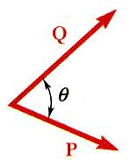
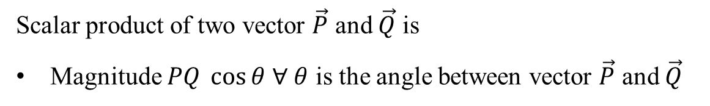
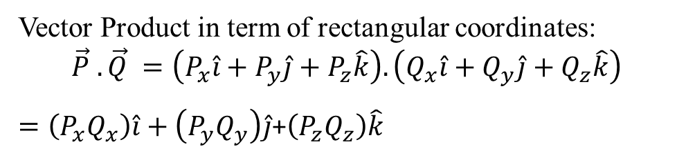
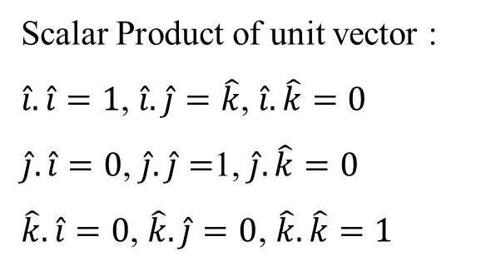
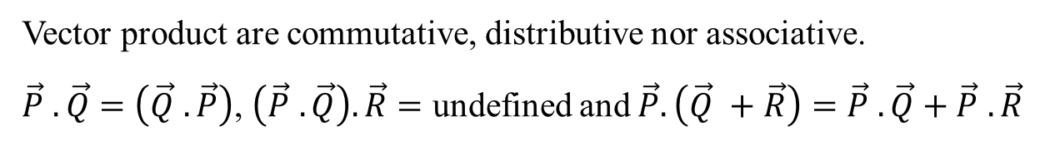
Dot Product (Scalar Product)
Scalar product of two vector $\vec{P}$ and $\vec{Q}$ is
Magnitude $PQ \cos{θ}$ $∀$ $θ$ is the angle between vector $\vec{P}$ and $\vec{Q}$
Vector product are commutative, distributive nor associative.
$\vec{P}$ $.\vec{Q}$ $=\left(\vec{Q} .\vec{P}\right)$, $\left(\vec{P} .\vec{Q}\right).\vec{R}=$ undefined and $\vec{P}.\left(\vec{Q} +\vec{R}\right)=$ $\vec{P}$ $.\vec{Q}+\vec{P}$ $.\vec{R}$
Scalar Product of unit vector :
$\hat{i}.\hat{i}=1$, $\hat{i}.\hat{j}=\hat{k}$, $\hat{i}.\hat{k}=0$
$\hat{j}.\hat{i}=0$, $\hat{j}.\hat{j}=$1, $\hat{j}.\hat{k}=0$
$\hat{k}.\hat{i}=0$, $\hat{k}.\hat{j}=0$, $\hat{k}.\hat{k}=1$
Vector Product in term of rectangular coordinates:
$$\vec{P} .\vec{Q} =\left(P_{x}\hat{i}+P_{y}\hat{j}+P_{z}\hat{k}\right).\left(Q_{x}\hat{i}+Q_{y}\hat{j}+Q_{z}\hat{k}\right)$$
$=\left(P_{x}Q_{x}\right)\hat{i}+\left(P_{y}Q_{y}\right)\hat{j}$+$\left(P_{z}Q_{z}\right)\hat{k}$

Slide 4
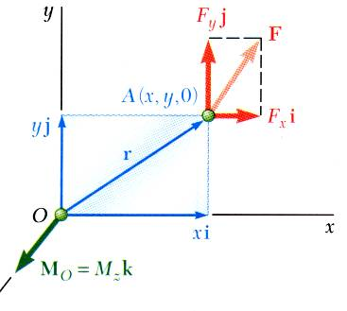
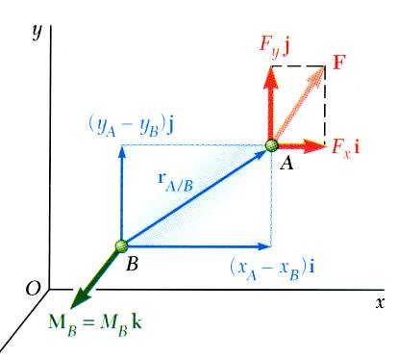
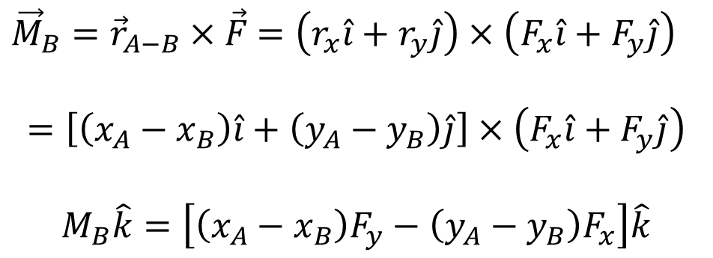
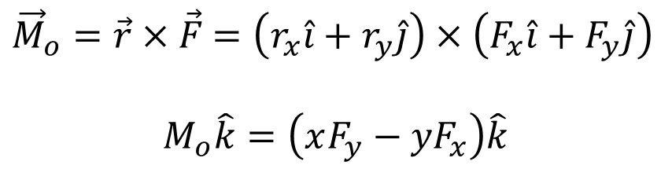
Moment in 2-Dimension
${\vec{M}}_{o}=\vec{r}×\vec{F}$ $=\left(r_{x}\hat{i}+r_{y}\hat{j}\right)×\left(F_{x}\hat{i}+F_{y}\hat{j}\right)$
$$M_{o}\hat{k}=\left(xF_{y}−{yF}_{x}\right)\hat{k}$$
${\vec{M}}_{B}={\vec{r}}_{A−B}×\vec{F}$ $=\left(r_{x}\hat{i}+r_{y}\hat{j}\right)×\left(F_{x}\hat{i}+F_{y}\hat{j}\right)$
$$=\left[\left(x_{A}−x_{B}\right)\hat{i}+\left(y_{A}−y_{B}\right)\hat{j}\right]×\left(F_{x}\hat{i}+F_{y}\hat{j}\right)$$
$$M_{B}\hat{k}=\left[\left(x_{A}−x_{B}\right)F_{y}−{\left(y_{A}−y_{B}\right)F}_{x}\right]\hat{k}$$

Slide 5
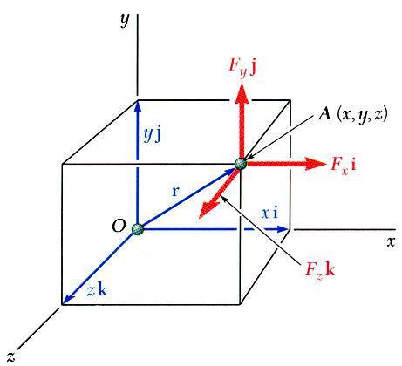
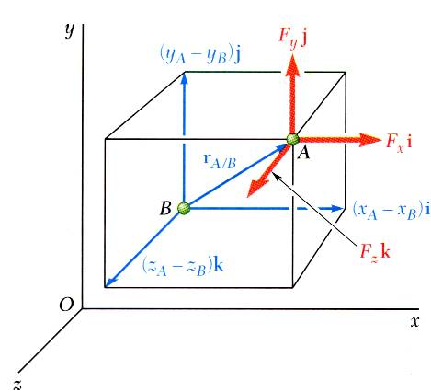
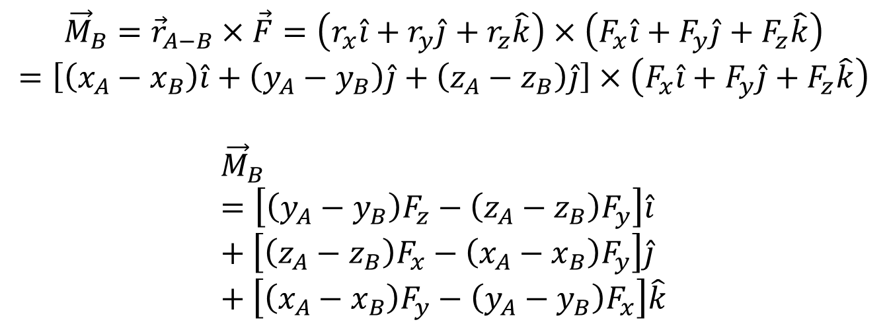
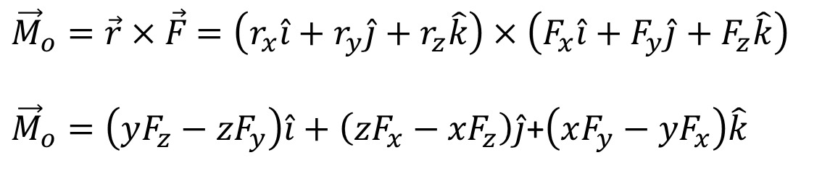
Moment in 3-Dimension
${\vec{M}}_{o}=\vec{r}×\vec{F}$ $=\left(r_{x}\hat{i}+r_{y}\hat{j}+r_{z}\hat{k}\right)×\left(F_{x}\hat{i}+F_{y}\hat{j}+F_{z}\hat{k}\right)$
${\vec{M}}_{o}=\left(yF_{z}−{zF}_{y}\right)\hat{i}+\left(zF_{x}−{xF}_{z}\right)\hat{j}$+$\left(xF_{y}−{yF}_{x}\right)\hat{k}$
$${\vec{M}}_{B}={\vec{r}}_{A−B}×\vec{F}=\left(r_{x}\hat{i}+r_{y}\hat{j}+r_{z}\hat{k}\right)×\left(F_{x}\hat{i}+F_{y}\hat{j}+F_{z}\hat{k}\right)$$
$$=\left[\left(x_{A}−x_{B}\right)\hat{i}+\left(y_{A}−y_{B}\right)\hat{j}+\left(z_{A}−z_{B}\right)\hat{j}\right]×\left(F_{x}\hat{i}+F_{y}\hat{j}+F_{z}\hat{k}\right)$$
$${\vec{M}}_{B}=\left[\left(y_{A}−y_{B}\right)F_{z}−{\left(z_{A}−z_{B}\right)F}_{y}\right]\hat{i}+\left[\left(z_{A}−z_{B}\right)F_{x}−{\left(x_{A}−x_{B}\right)F}_{y}\right]\hat{j}+\left[\left(x_{A}−x_{B}\right)F_{y}−{\left(y_{A}−y_{B}\right)F}_{x}\right]\hat{k}$$

Slide 6
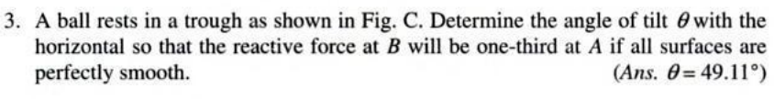
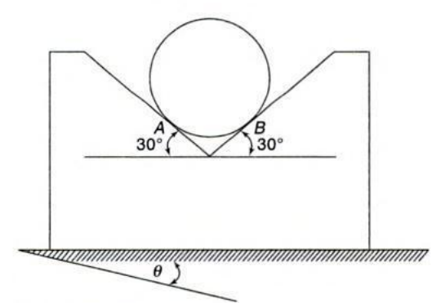
Problem

Slide 7
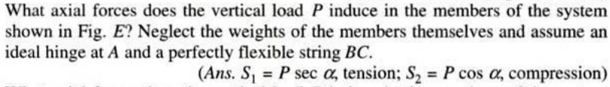
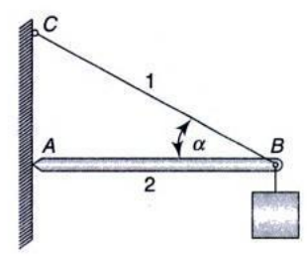
Problem

Slide 8
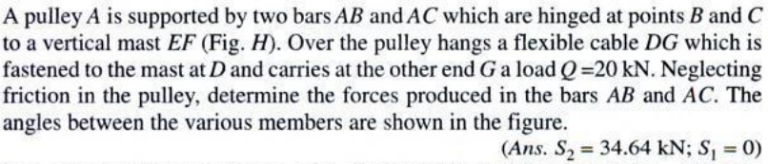
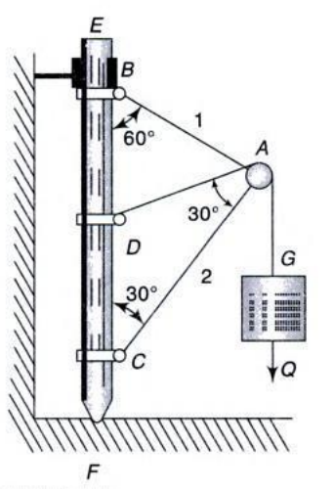
Problem

Slide 9
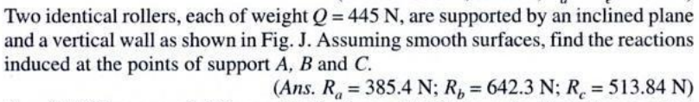
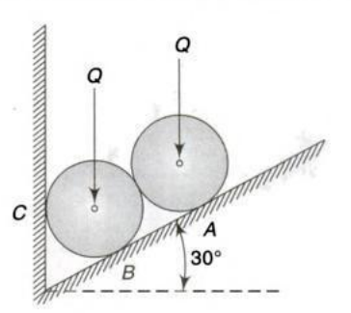
Problem

Slide 10
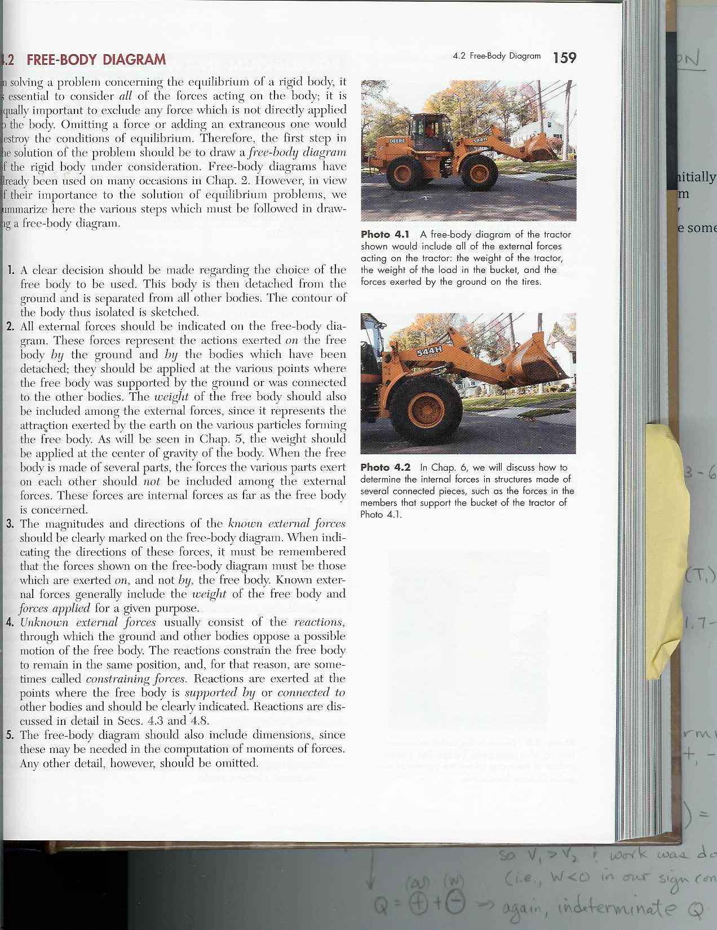
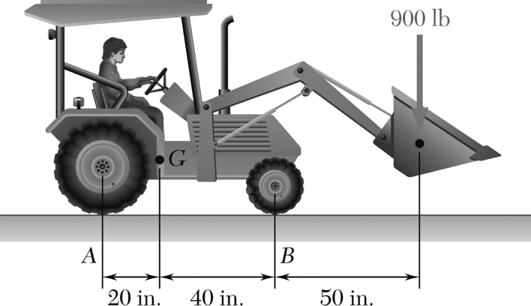
Problem
A 2100-lb tractor is used to lift 900 lb of gravel. Determine the reaction at each of the two rear wheels and two front wheels

Slide 11
Engineering Mechanics (Problem 1)
A 500-N vertical force is applied to the end of a lever which is attached to a shaft at O. Determine:
moment about O,
horizontal force at A which creates the same moment,
smallest force at A which produces the same moment,
location for a 1200-N vertical force to produce the same moment,
whether any of the forces from b, c, and d is equivalent to the original force.

Slide 12
Engineering Mechanics (Problem 1)

Slide 13
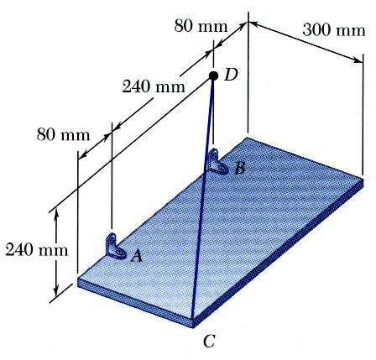
Engineering Mechanics (Problem 2)
The rectangular plate is supported by the brackets at A and B and by a wire CD. Knowing that the tension in the wire is 200 N, determine the moment about A of the force exerted by the wire at C.

Slide 14
Engineering Mechanics (Problem 3)

Slide 15
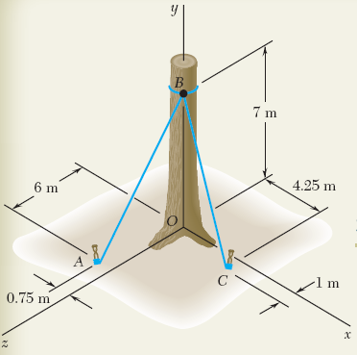
Engineering Mechanics (Problem 3)
Before the trunk of a large tree is felled, cables AB and BC are attached as shown. Tensions in cables AB and BC are 555N and 660N, respectively.
Determine the moment about O of the resultant force exerted on the tree by the cables at B.

Slide 16
Engineering Mechanics (Problem 3)

Slide 17
Engineering Mechanics (Problem 4)
Determine the components of the single couple equivalent to the couples shown.

Slide 18
Engineering Mechanics (Problem 4)

Slide 19
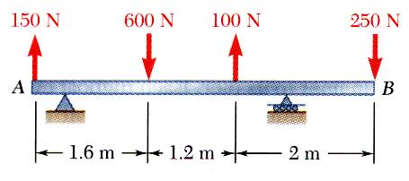
Engineering Mechanics (Problem 5)
For the beam, reduce the system of forces shown to (a) an equivalent force-couple system at A, (b) an equivalent force couple system at B, and (c) a single force or resultant.
Note: Since the support reactions are not included, the given system will not maintain the beam in equilibrium.

Slide 20
Engineering Mechanics (Problem 5)

Slide 21
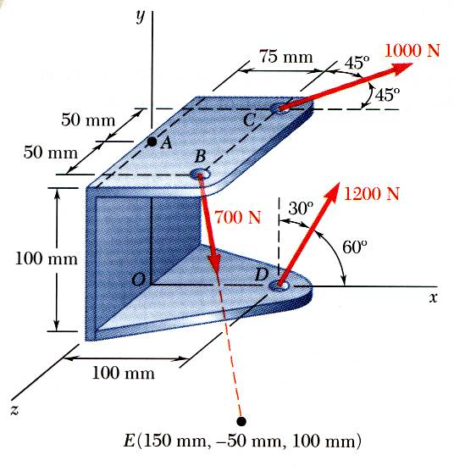
Engineering Mechanics (Problem 6)
Three cables are attached to the bracket as shown. Replace the forces with an equivalent force-couple system at A.

Slide 22
Engineering Mechanics (Problem 6)

Slide 23
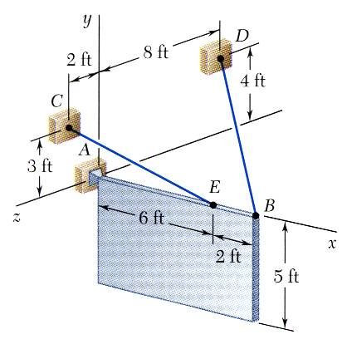
Problem
A sign of uniform density weighs 270 lb and is supported by a ball-and-socket joint at A and by two cables.
Determine the tension in each cable and the reaction at A.

Slide 24
Acknowledgement
NPTEL lectures on Engineering Mechanics
en.wikipedia.org/wiki
britannica.com
Beer & Johnston, Vector Mechanics for Engineers
Meriam & Kraige, Engineering Mechanics
Problems taken from internet sources

Slide 25
Acknowledgement
NPTEL lectures on Engineering Mechanics
en.wikipedia.org/wiki
Beer & Johnston, Vector Mechanics for Engineers
Meriam & Kraige, Engineering Mechanics
Timoshenko & Young, Engineering Mechanics
Problems taken from internet sources

